Slide 1
Student data privacy integration into existing purchasing procedures
Principals meeting
Tuesday, September 17, 2019

Slide 2
Student data privacy and third party contractors
Any app or program that collects any personally identifiable student data (i.e., anything that requires a student to enter unique login credentials) has to be vetted for data privacy. We check:
The vendor’s Privacy Policy
The vendor’s Terms and Conditions
Network security (Information Systems)
If any of these things do not meet the minimum requirements of the Utah Student Privacy and Data Protection Act, then we can’t legally use it.

Slide 3
Student data privacy and third party contractors
If everything checks out, the vendor will be asked to sign a Data Privacy Agreement (DPA) in which they agree to:
Use student data strictly for the service for which they are contracted
Store and protect student data using industry-level standards
Not sell student data
Not use targeted advertising
Report any data breaches
Delete student data if we ask them to
Be willing to subject themselves to an audit if we wish

Slide 4
So how does this affect you and your school?
Before a purchase of an app, software program, or online software subscription can be approved:
Information Systems vets the program for security
Evaluation, Research & Accountability vets the program for student data privacy
ERA solicits the signed DPA
Once this is done, the purchase approval process may move forward

Slide 5
So how does it work?

Slide 6
So how does it work?
School submits program to be purchased to the Purchasing Department as normal (complete with requisite quotes and documentation)
Purchasing sends request to ERA for vetting
ERA vets the vendor’s privacy policy and terms and conditions
ERA requests that Information Systems check the program for network security, if necessary

Slide 7
So how does it work?
ERA works with the vendor to make necessary adjustments and sign the Data Privacy Agreement
ERA works with the requesting school if there are usage issues or restrictions that come up
ERA notifies Purchasing of approval or denial

Slide 8
Things to note:
Depending on how quickly the vendor responds, this vetting process typically takes 2-3 days, but leave yourself time because vendors:
Typically have their attorneys examine our DPA
Often try to negotiate conditions within the DPA
Require that we use their data privacy agreement
Refuse to sign

Slide 9
Here’s what we need you to do:
Assign someone at your school to be the designated Student Data Privacy Representative
This could be your computer lab aide, library media specialist, assistant principal, teacher, etc.
Their responsibility will simply be to do a preliminary student data privacy check for all new apps or websites that will be used as part of classroom instruction
Fill out the survey with that person’s name and contact information
We will invite them to a short training in the near future
Survey Link: https://tinyurl.com/y58k9wut

Slide 10
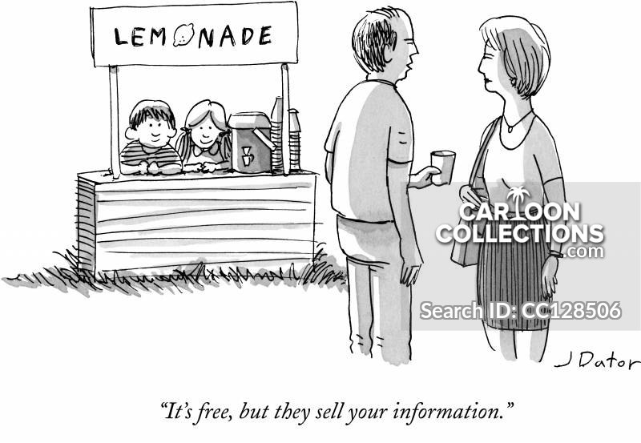
Questions?

