Slide 1
Leading School Community Councils
Jordan School District

Slide 2
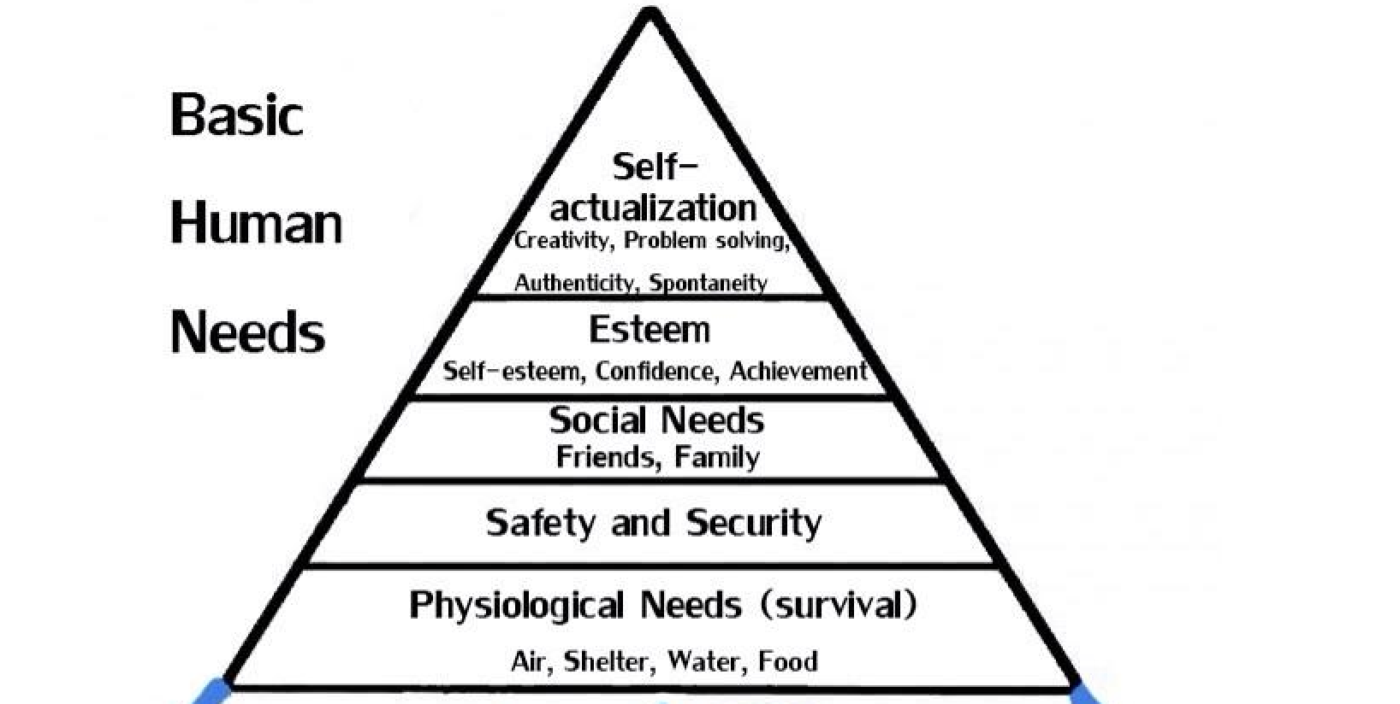

Slide 3
Overview
The “Why”
The “What”
Who?
How?
Responsibilities of the SCC
School Improvement & LAND Trust Plans

Slide 4
Intros and Discussion
Brief Introductions
What is one thing that makes your school great?

Slide 5
School Community Councils are required by law.
Established by JSD in 1992 Required by State Law in 2002

Slide 6
The purposes for school community councils are:
To build consistent, effective collaboration and communication among parents, employees and administrators
To allow parents an opportunity to be actively involved with the school in their children’s education
To make good schools great
Notes:
6

Slide 7
The Work of SCCs
School Improvement Plan and input on the TSSA
Reading achievement plan (elementary schools)
Prepare School LAND Trust Plan
Digital Citizenship review
Advise and make recommendations to school and district administrators and local school board

Slide 8
Council Membership
Principal and at least one school employee
Parent/guardian members
Must have at least 2 parent majority
Size is determined by the council
Stated in Rules of Order and Procedure (required)
Member terms are 2 years
Terms are staggered

Slide 9
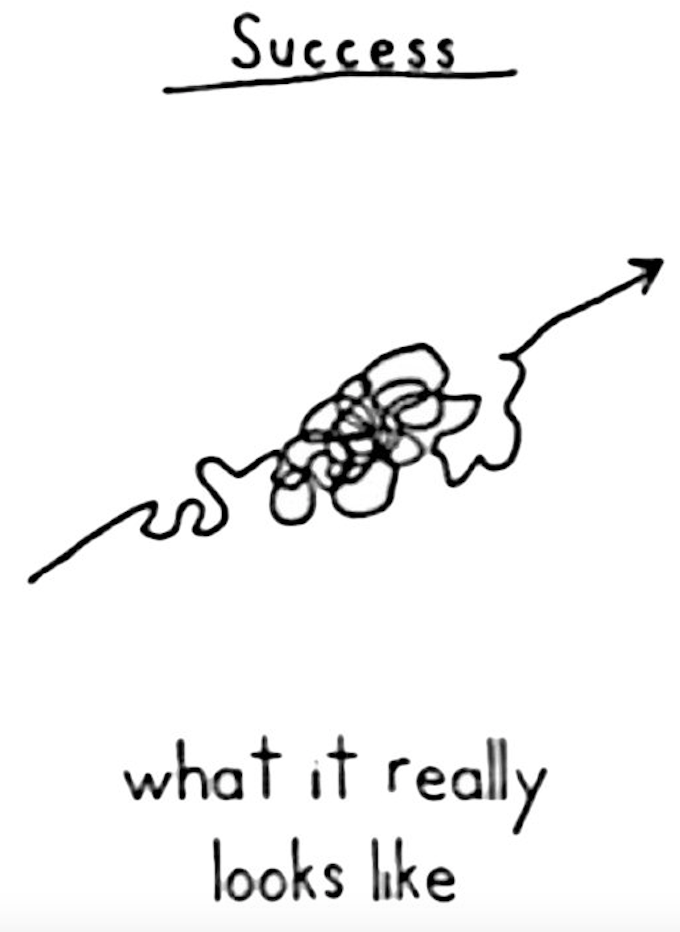

Slide 10
Council Membership Roles
Principals-automatic council seat
Access and explain data
Ambassador
Resource to the chair and council
School Employees-elected by peers, 2 year term
Long-term vision of the school
Academic perspective
Parents-may be elected by other parents, 2 year term
It is about their children
Parent and community perspective

Slide 11
Member Elections (If needed)
Provide at least 21 days’ notice before the date that voting commences
Voting must extend for a period of at least three consecutive school days
School must post:
The dates and times of the elections
A list of council positions that are up for election
Instructions for becoming a candidate for a community council position

Slide 12
Election of Chair & Vice-chair
The entire council elects their officers.
Chair is elected from parent members
Vice-chair may be a parent or employee
Principals don’t serve as officers but do vote
Voice vote may be done
If desired or contested: Secret Ballot, principal oversees with 1 employee and 1 parent
Appoint a member to take minutes

Slide 13
Conducting Meetings
Open to members of the public
No public discussion of HR issues
Managing the meeting
Begin on time & follow the agenda
Allow enough time for each agenda item
Keep the council on task & move the agenda along to end on time
Encourage all viewpoints to be heard
Motions for action items – quorum present
Comments and motions should go through the chair
Best for the chair to conduct when present

Slide 14
Responsibilities of Members
To make a conscientious effort to attend all meetings.
To act in good faith for the benefit of all students.
To participate in the development of the School Land Trust Plan and give feedback on the TSSA plan.
To be a positive and contributing member.

Slide 15
Teacher and Student Success Act (TSSA)
New in 2019-20 and distinct from the LAND Trust program
TSSA provides money directly to each Utah public school
Address needs unique to the school
To qualify for the money, schools must adhere to the parameters approved by the school board.
Requires input from the School Community Council (SCC)
SCC members should become familiar with the TSSA

Slide 16
Website Requirements
Contact information of the SCC members
Meeting Agendas—posted 1 week before with date, time, place
Minutes for current school year meetings
Substance of matters proposed, discussed or decided, it must be on the agenda to take action
Teacher and Student Success Plan
Opportunities provided to parents by serving on the SCC and how parents can directly influence expenditure of LAND Trust money
Dollar amounts received by the school each year through the program

Slide 17
Rules of Order and Procedure
School Community Councils must adopt their own rules of order and procedure. These rules should be followed in conducting meetings, be posted on the school website, and be available at each meeting.
Removal or Replacement, Elections, How to make decisions, etc.
Must be posted on the SCC website
See sample at http://www.schoollandtrust.org/training/

Slide 19
School LAND Trust Plans

Slide 20
“It is a capital mistake to theorize before one has data. Insensibly one begins to twist facts to suit theories, instead of theories to suit facts.” ― Sir Arthur Conan Doyle, Sherlock Holmes

Slide 21
USBE Data Gateway
Allows public access to education-related data.
Helps make informed decisions about student learning.
No personal information is given.
https://datagateway.schools.utah.gov/

Slide 22
Discussion
Take a few minutes to discuss with your principal, chair or neighbor how you will use data in an upcoming SCC meeting.

Slide 23
S.M.A.R.T. Goals are…
Student Centered
Measurable
Academic
Realistic
Timely

Slide 24
School LAND Trust Plan
Usually includes part of the TSSA plan
Describe how the school will improve or enhance academic achievement
Use money from the LAND Trust Allocation to fund the plan

Slide 25
School LAND Trust Plan
Identify an academic need from the School Improvement Plan to address.
Write a goal to address the need. Include all the components of SMART goals
Majority vote of a quorum is required
Submit online for approval by the local school board
Implement the plan as approved

Slide 26
Plan Approval SCC Expenditures
Should be used for data-driven and evidence-based practices and services
Local boards and districts may not require a council to spend SCC funds on a specific use or set of uses
An SCC council may spend no more than $7000
Civic and character education
Digital citizenship training

Slide 27
A word about carry-over Funds
They can be carried to the next year
If it is > 10% you will need to explain
In the early years it made some sense
Can be perceived that schools must not really need it
School LAND Trust Plans may be amended!

Slide 28
School LAND Trust Funds Summary
Appropriated by the legislature
Only state that spends the funds at each school
Tailored to meet the needs of individual schools
Can be carried over

Slide 29
So, Why is it called LAND Trust?

Slide 30
L.A.N.D.
Learning
And
Nurturing
Development

Slide 31
4 Types of Land
Private
Federal
State
Trust - held in perpetuity for the school children of Utah

Slide 32
Congressional Land Grant Intent

Slide 33
A state with 3.4 million acres

Slide 34
Derrick Platform – Vernal – Uintah County

Slide 35
Loader and Feeder – Price – Carbon County

Slide 36
Funding Flow Chart
Revenues Generated From Activities on School Trust Lands
Interest
Trust Land Management Expenses
Permanent State School Fund
Dividends
$ for Utah Schools
Capital Gains
Reinvested

Slide 37
1987 Balance: $ 15,271,659

Slide 38
2020 fund balance: over $2,500,000,000
The 2020-21 distribution to schools was $88,466,181

Slide 39
The primary focus must be: What is in the best interest of students?

Slide 40
Questions?
Contact your local principal
Call or email Cody Curtis
cody.curtis@jordandistrict.org
801-567-8167
http://jordandistrict.org/schools/communitycouncil/

