Slide 1
Celebrating JSD: MAKING A DIFFERENCE
Superintendent Patrice A. Johnson
PRINCIPALS MEETING SEPTEMBER 2017

Slide 3
Collective Teacher Efficacy
What is Collective Teacher Efficacy?
Belief of teacher group about collective ability to promote successful student outcomes within their school

Slide 4
Elementary School #1 - 4th Grade Team
Total Proficiency 68%
Growth (MGP) 51
Teacher | ELA Proficiency
A | 88%
B | 84%
C | 63%
D | 60%
E | 60%
F | 50%
Notes:
Elementary School A = Jordan Ridge Elementary
Elementary School B = Rose Creek Elementary
Elementary School C = Blackridge Elementary
Elementary School D = Hayden Peak Elementary

Slide 5
Elementary School #2 - 4th Grade Team
Total Proficiency 67.8%
Growth (MGP) 61
Teacher | Math Proficiency
A | 82%
B | 77%
C | 70%
Notes:
Elementary School A = Jordan Ridge Elementary
Elementary School B = Rose Creek Elementary
Elementary School C = Blackridge Elementary
Elementary School D = Hayden Peak Elementary

Slide 6
Elementary School #3 - 6th Grade Team
Total Proficiency 61.4%
Growth (MGP) 58
Teacher | ELA Proficiency
A | 70%
B | 67%
C | 67%
D | 67%
E | 67%
F | 50%
Notes:
Elementary School A = Jordan Ridge Elementary
Elementary School B = Rose Creek Elementary
Elementary School C = Blackridge Elementary
Elementary School D = Hayden Peak Elementary

Slide 7
Elementary School #4 - 3rd Grade Team
Total Proficiency 67%
Teacher | Math Proficiency
A | 75%
B | 71%
C | 70%
D | 67%
E | 62%
F | 55%
Notes:
Elementary School A = Jordan Ridge Elementary
Elementary School B = Rose Creek Elementary
Elementary School C = Blackridge Elementary
Elementary School D = Hayden Peak Elementary

Slide 8
Middle School #1 - 7th Grade Science Team
Total Proficiency 78%
Growth (MGP) 89
Teacher | Science Proficiency
A | 83%
B | 76%
C | 74%
Notes:
Middle School A = Copper Mountain Middle
Middle School B = Fort Herriman Middle
High School A = Riverton High

Slide 9
Middle School #2 - 8th Grade Science Team
Total Proficiency 72%
Growth (MGP) 75
Teacher | Science Proficiency
A | 76%
B | 74%
C | 66%
Notes:
Middle School A = Copper Mountain Middle
Middle School B = Fort Herriman Middle
High School A = Riverton High

Slide 10
High School Physics Team
Total Proficiency 58%
Growth (MGP) 64
Teacher | Science Proficiency
A | 70%
B | 65%
C | 65%
D | 52%
E | 43%
Notes:
Middle School A = Copper Mountain Middle
Middle School B = Fort Herriman Middle
High School A = Riverton High

Slide 11
JSD Areas of Focus – 2017
1. STUDENT ACHIEVEMENT
Refining PLCs Alignment and Clarity of Student Success Criteria Analyze Formative Data to Inform Instruction Continue Intervention and Enrichment (80/20) High Quality Instruction Depth of Knowledge Engagement thru High Impact Strategies Continuous Monitoring of/for Student Learning
2. EMPOWERING EMPLOYEES
Professional development Opportunity for growth Recognizing teachers as professionals Recognizing and rewarding quality performance
DRAFT
3. CUSTOMER SERVICE
Welcoming culture Inclusive environment Address problems Partner with parents
4. SAFETY & SECURITY
Physically & emotionally safe schools Safe & welcoming environment Code of Conduct Anti-bullying programs

Slide 12
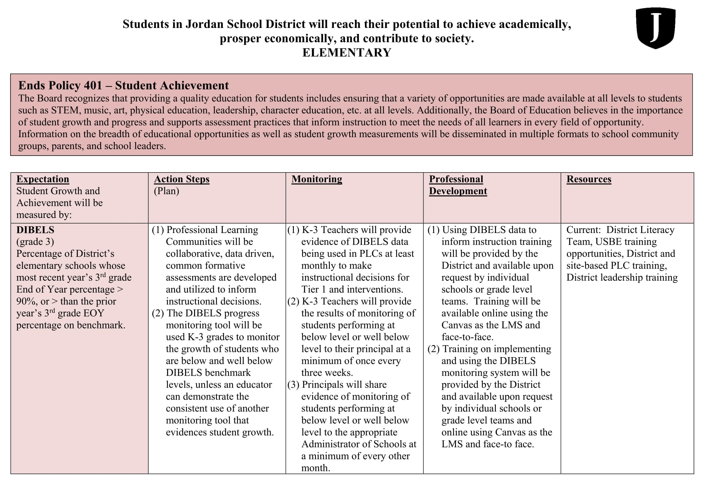
Student Achievement
Elementary

Slide 13
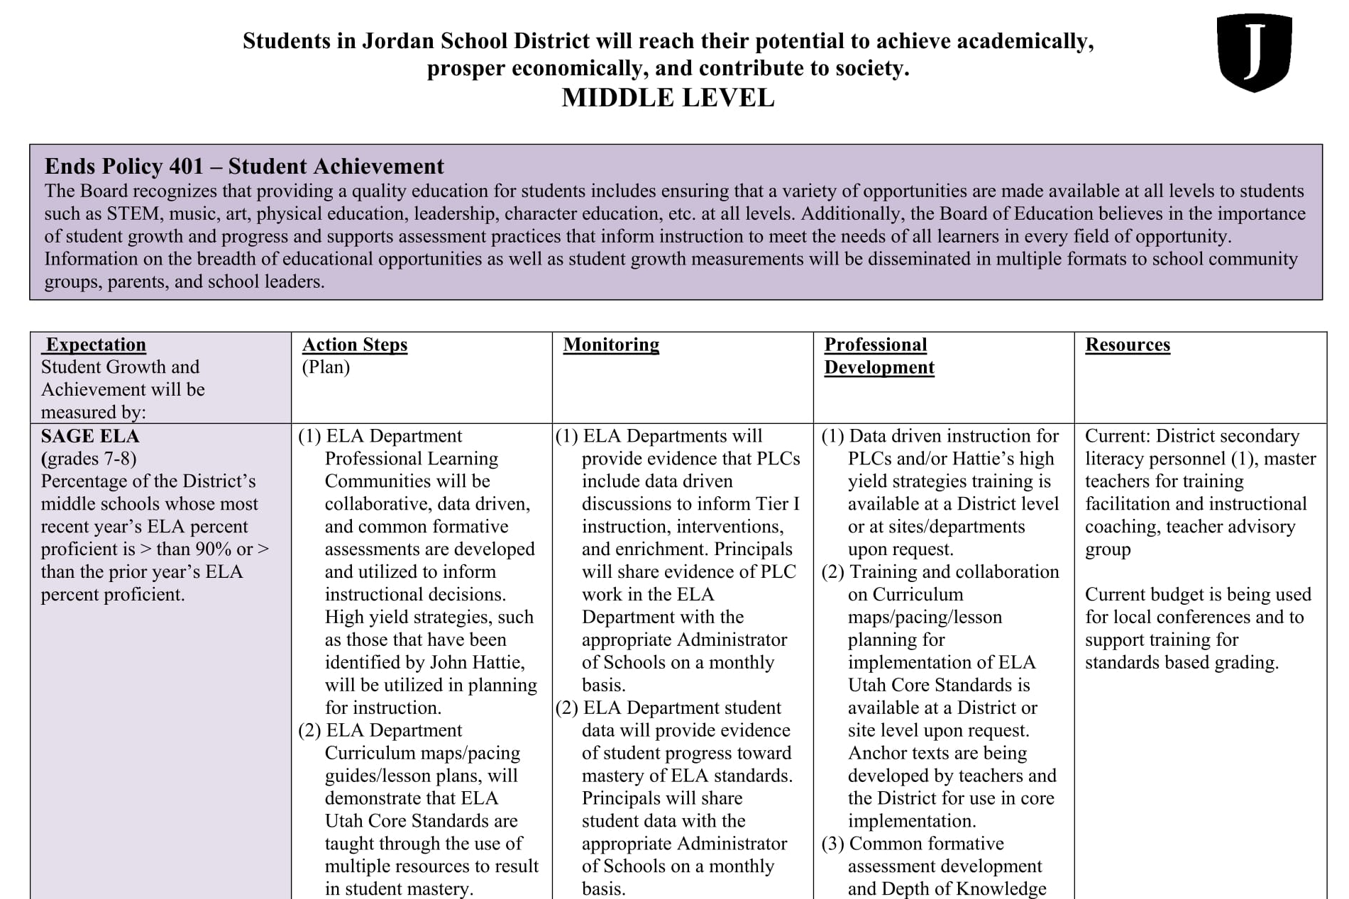
Student Achievement
Middle Level

Slide 14
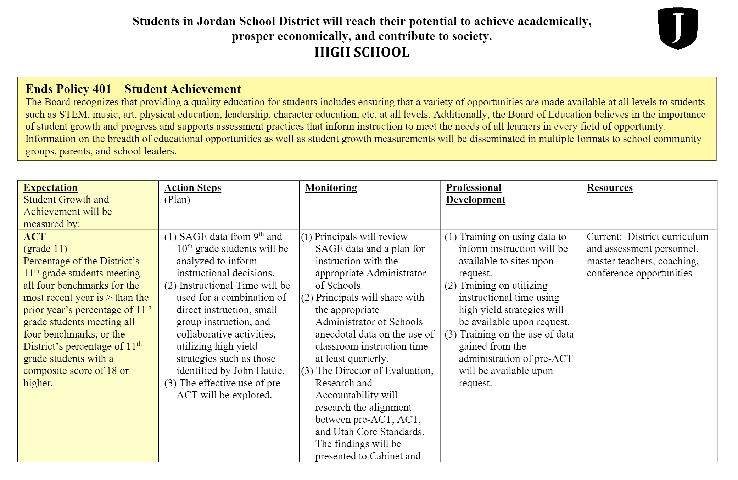
Student Achievement
High School

Slide 15
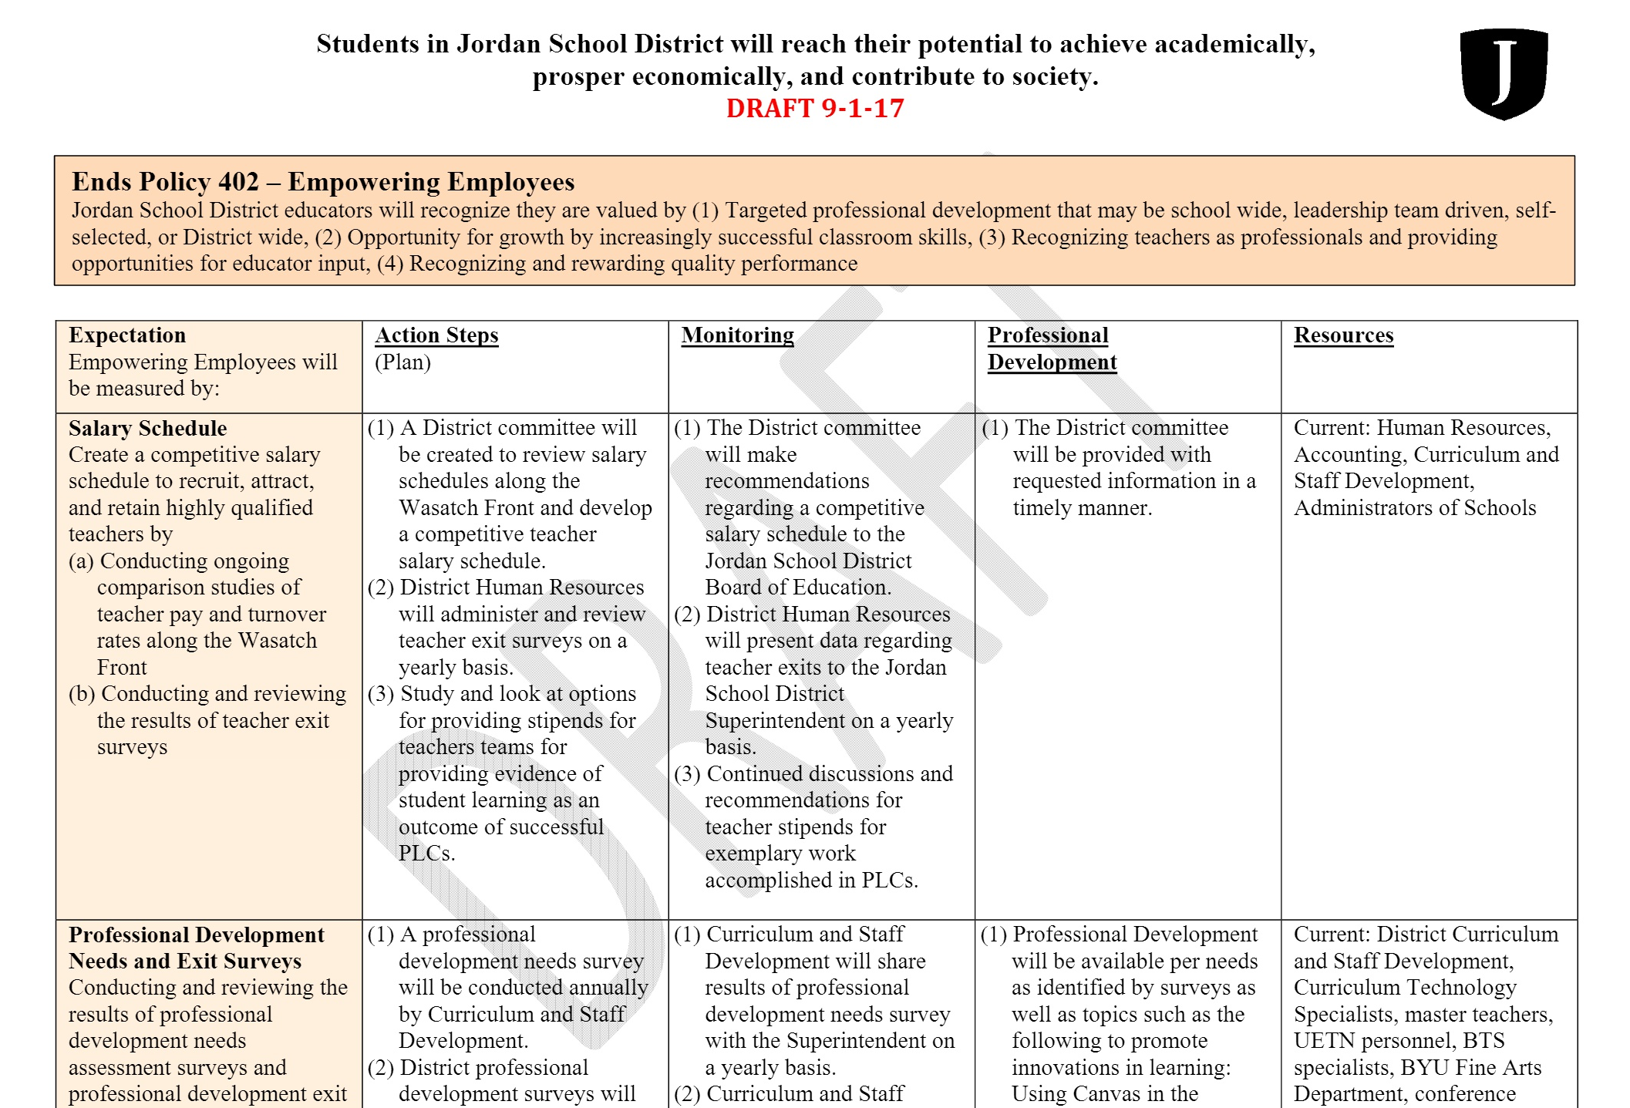
Empowering Employees

Slide 16
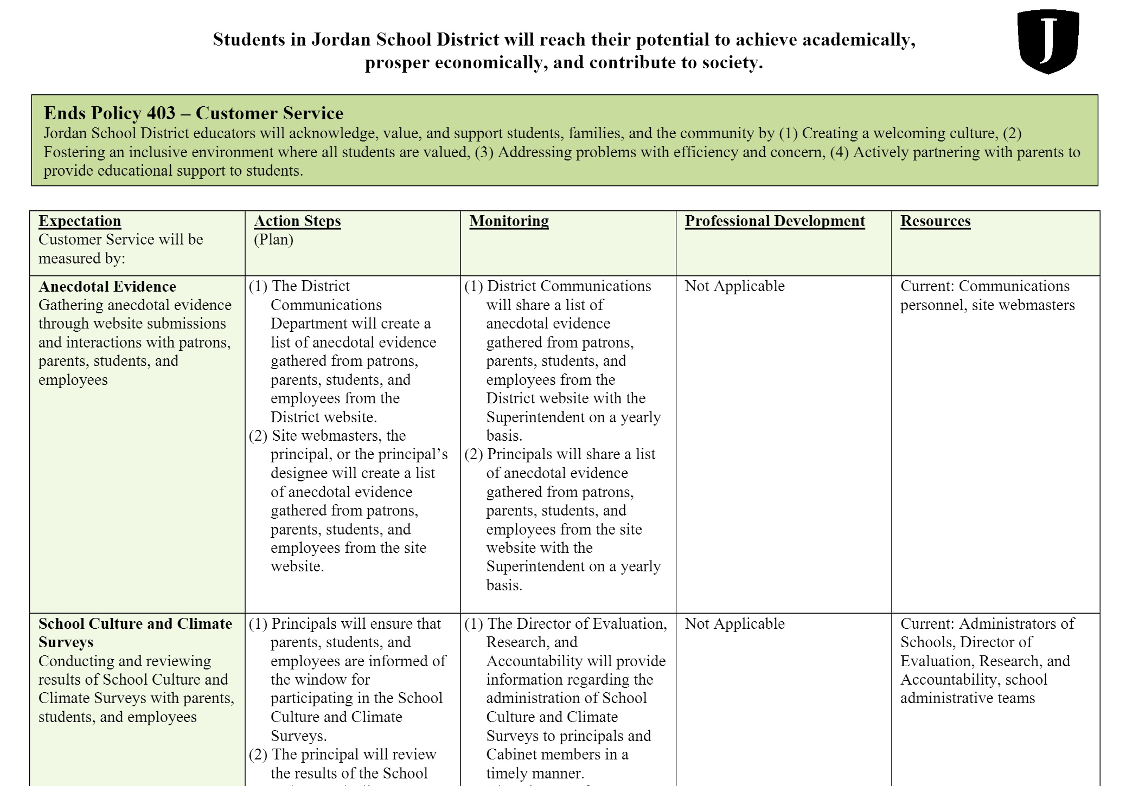
Customer Service

Slide 17
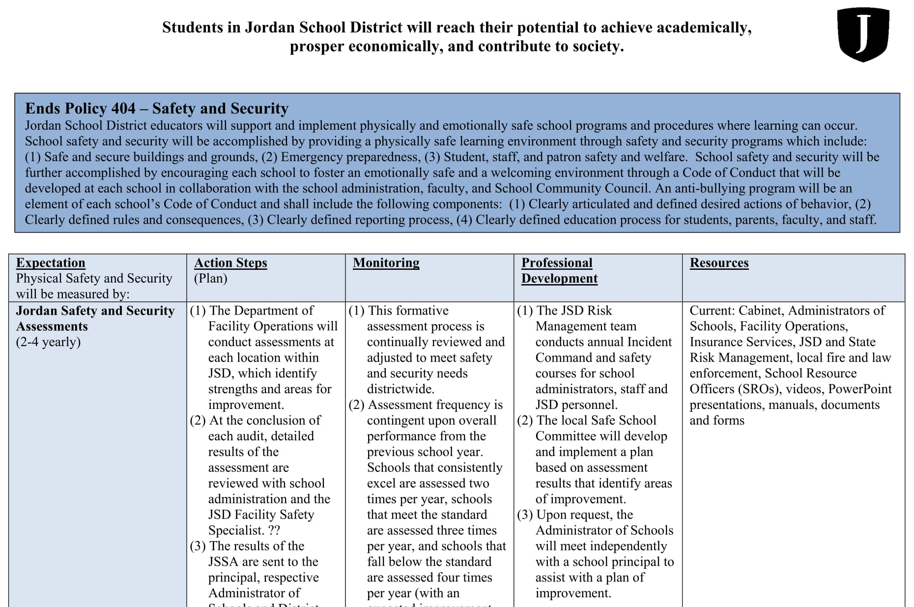
Security and Safety
(Physical and Emotional)

Slide 19
Influence | Effect Size | Rank | Influence | Effect Size | Rank
Collective teacher efficacy | 1.57 | 1 | Clickers | 0.22 | 189
Cognitive task analysis | 1.25 | 5 | One to one laptops | 0.16 | 206
Jigsaw method | 1.2 | 7 | Mentoring | 0.12 | 212
Deliberative practice | 0.79 | 18 | Charter schools | 0.09 | 221
Summarization | 0.79 | 19 | School calendars/schedules | 0.09 | 222
Rehearsal and memorization | 0.73 | 29 | Performance pay | 0.05 | 231
Outlining and transforming | 0.66 | 39 | Multi-grade/multi-age classes | 0.04 | 232
Self verbalization and self questioning | 0.55 | 64 | Presence of humor | 0.04 | 233
Underlining and highlighting | 0.5 | 83 | Immigrant status | 0.01 | 236
Relative age in class | 0.45 | 107 | Sleep | -0.05 | 240
Philosophy in schools | 0.43 | 110 | Not liked in class | -0.19 | 245
Cell phones | 0.35 | 134 | Suspension/expelling students | -0.2 | 246
Ethnicity | 0.32 | 141 | Corporal punishment in the home | -0.33 | 249
Pre-school programs | 0.29 | 160 | Depression | -0.36 | 251
Matching style of learning | 0.22 | 180 | Boredom | -0.49 | 252

Slide 20
Student achievement
Refining PLCs
Alignment and Clarity of Student Success Criteria
Analyze Student Data to Inform Instruction
Continued Intervention and Enrichment (80/20)
High Quality Instruction
Depth of Knowledge (with Alignment)
Engagement thru High Impact Strategies
Continuous Monitoring of/for Student Learning

Slide 21
Collective
Efficacy
refers to an organization’s
shared belief that through their collective action, they can positively influence student outcomes, including those who are disengaged and/or disadvantaged.

Slide 22
WE
are making a

Slide 23
EVERY CHILD
EVERY DAY

