Slide 1
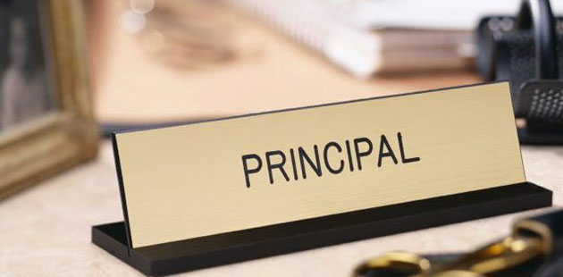
What you always wanted to know…….
Notes:
Lisa will welcome

Slide 2

Who is new?
Notes:
We will introduce ourselves. Three Musketeers..All for one and one for All. Lisa and Doree will introduce their new people.

Slide 3

Starting Right!
Notes:
Video and then go to next slide - Doree

Slide 4
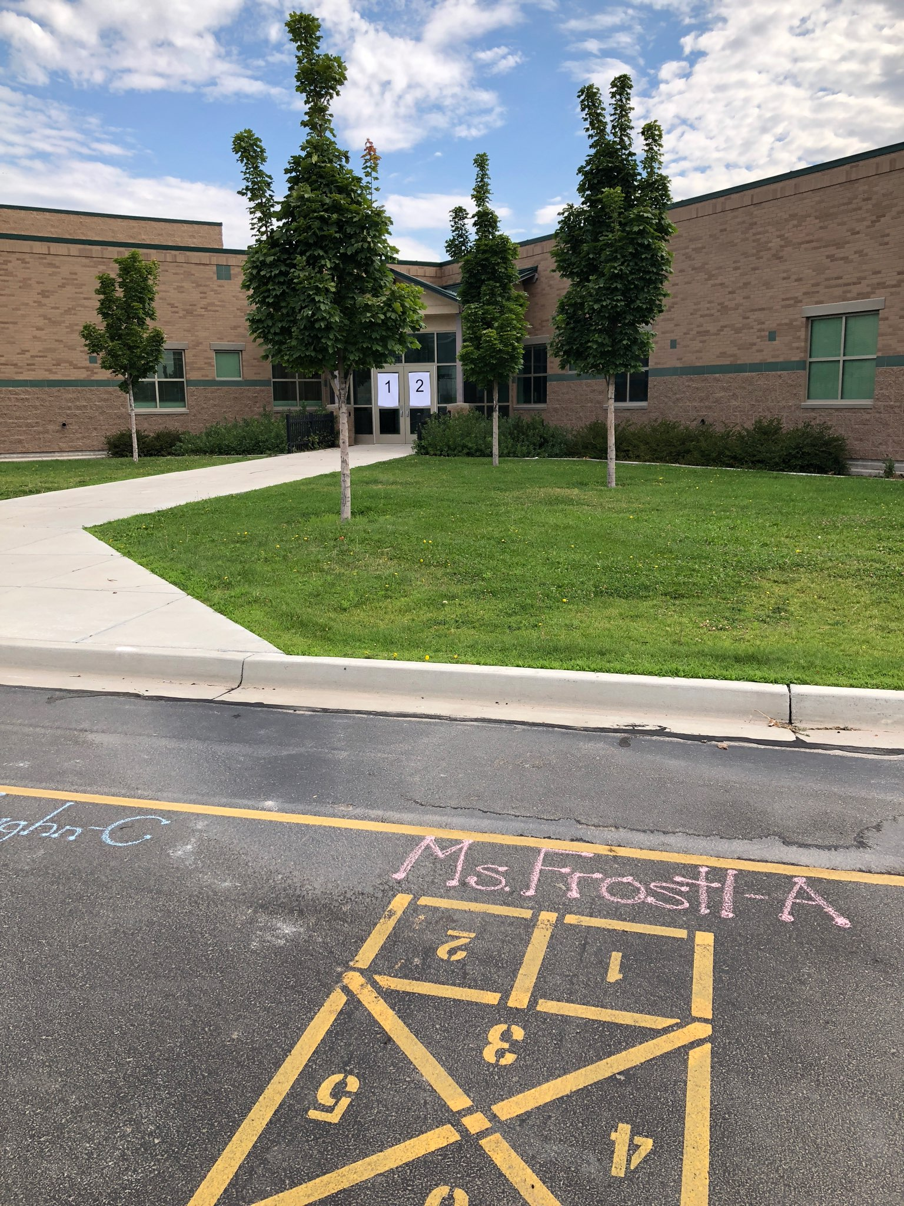
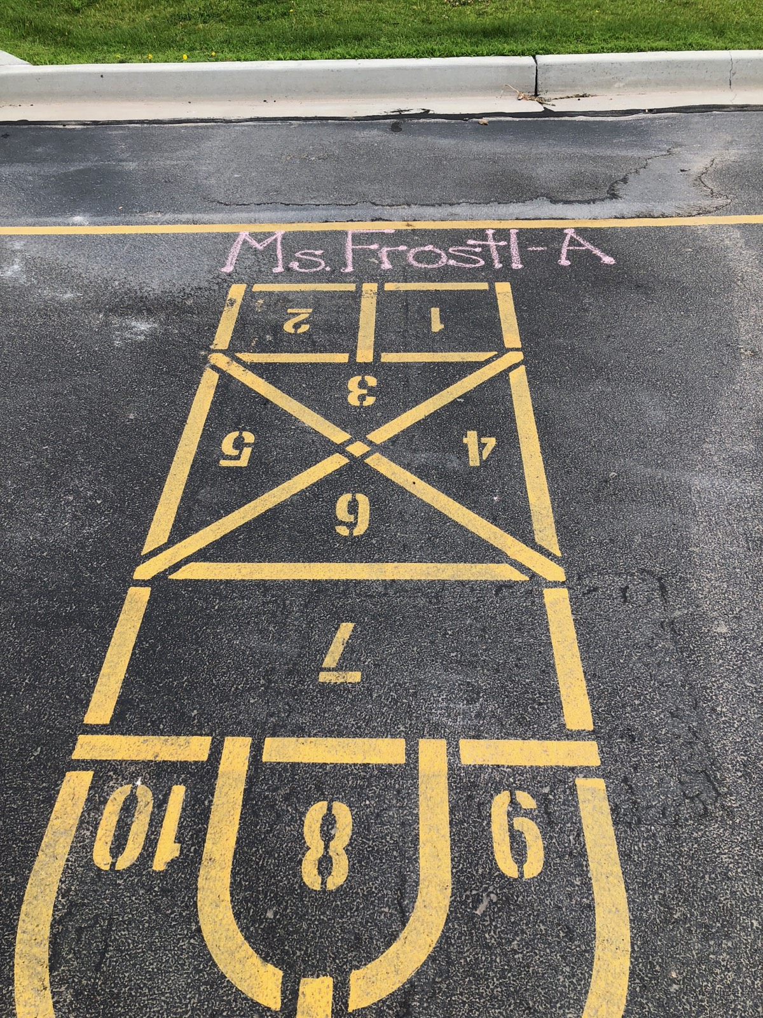
Notes:
Doree will talk about what Kevin had organized to start the year right. Realization that so many of you have systems that allow the year to start right. The activity that we would like to do is an opportunity for us all to learn from each other, collaborate, and get new ideas for starting right.

Slide 5

What’s up?
When is it happening?
PLCs, PTA/PTO,
SCC, Activities
Check it out/
Check it off
Notes:
Lisa will talk about the calendar, both the online and hard copy versions. Copies are in their folder. You will get a link from Peggy Margetts to add information about meeting schedules and activities.

Slide 6
Where are you?
Out of the Building..drop us a line…..
Vacation – How many days?
Personal Leave – How many days?
Need a Sub = 3+ days
Illness
Workshops/Inservices
Notes:
Laura – letting us know ahead of time

Slide 7

What’s new at school?
Skylert
Websites – What should be on a website?
School Newsletter?
Internal Newsletter?
Notes:
Doree talks about opportunities for communication. In person and phone call instead of an email response…

Slide 8
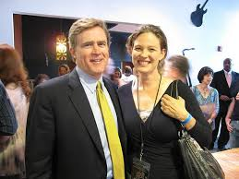

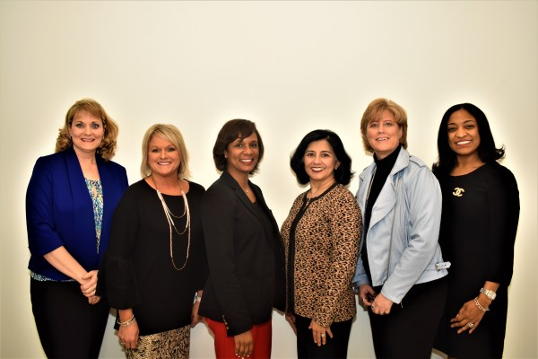

What to Wear?
Notes:
Laura will talk about professional dress, one day a week a school spirit day – business casual

Slide 9

What about finances?
Tracking Budgets
Trust Lands
Paying Assistants
Discretionary Staff
Awards
Outside Vendors
Notes:
Lisa will talk about finances – Monthly meeting with administrative assistant, knowing about the financial manual,
Spend you money in the year it is generated – don’t go over, we will help you, John will help you,
25 hour assistants are available for school based accounts, Use the correct codes, Keep an eye on true time.
Staff Rewards - Page 36 in the Financial Manual – Budget code 2002 – Pre-Approve with you AOS when you are buying out of staff rewards, Read John’s Email about outside vendors.
John - We still have problems with vendors coming into schools and departments to solicit business from our employees. They should not be doing this. The most frequent violator of this is retirement planners that pretend to be representing JSD Payroll Department or URS when they do not. URS is available for personal or school meetings if desired as has been advertised in JAM many times.
Emails are public record and therefore employees may receive solicitations on their district email. That does NOT mean we endorse the vendor or its products.

Slide 10
Bus Duty?
How does it work?
Equal number of times
$400.00
Someone else?
Notes:
Doree - trades are all or nothing, cannot opt out if no on wants to take their duty, looking at what is necessary. Cluster teachers get $800.00 – can’t trade

Slide 11
Notes:
Laura will do the wrap up. There are many people who help us………

