Slide 1
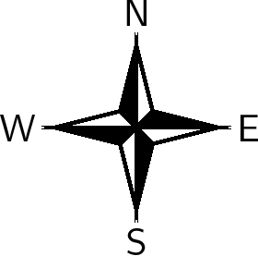
PM
LAYOUT

