Slide 1
KEEP Exit Remote Administration Materials

Slide 4
Question #5

Slide 20
Question #9

Slide 21
Question #9

Slide 22
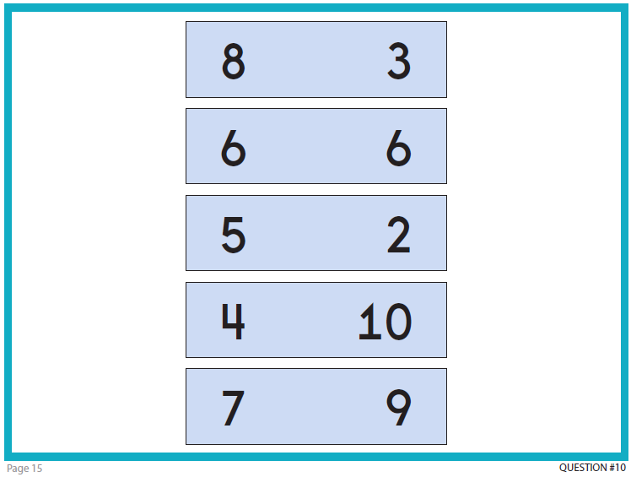

Slide 23
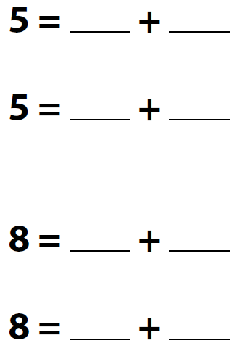
Question #11

Slide 24
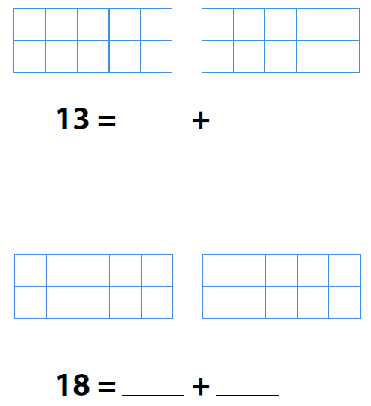
Question #12

