Slide 1
Leading School Community Councils
Jordan School District

Slide 2
Overview
Why SCCs?
Who?
How?
Responsibilities of the SCC
School Improvement & LAND Trust Plans

Slide 3
School Community Councils are required by law.
Established by JSD in 1992 Required by State Law in 2002

Slide 4
The purposes for School Community Councils are:
To build consistent, effective collaboration and communication among parents, employees and administrators
To allow parents an opportunity to be actively involved with the school in their children’s education
To make good schools great and be successful
Notes:
4

Slide 6
So, why is it called LAND Trust?

Slide 7
L.A.N.D.
Learning
And
Nurturing
Development

Slide 8
4 Types of Land
Private
Federal
State
Trust - held in perpetuity for school children of Utah

Slide 9
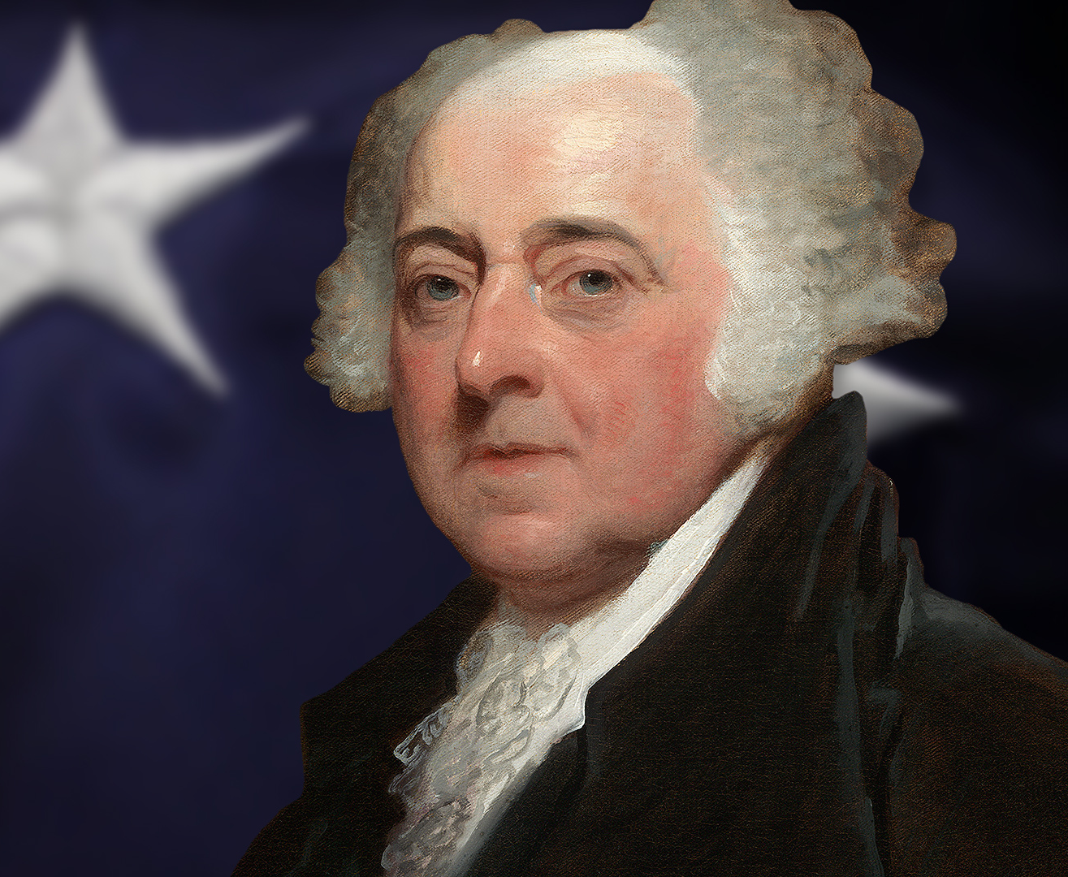
Public Education and our Founding Fathers
“There should not be a district of one mile square, without a school in it, not founded by a charitable individual, but maintained at the public expense of the people themselves.”
--John Adams

Slide 10
Congressional Land Grant Intent

Slide 11
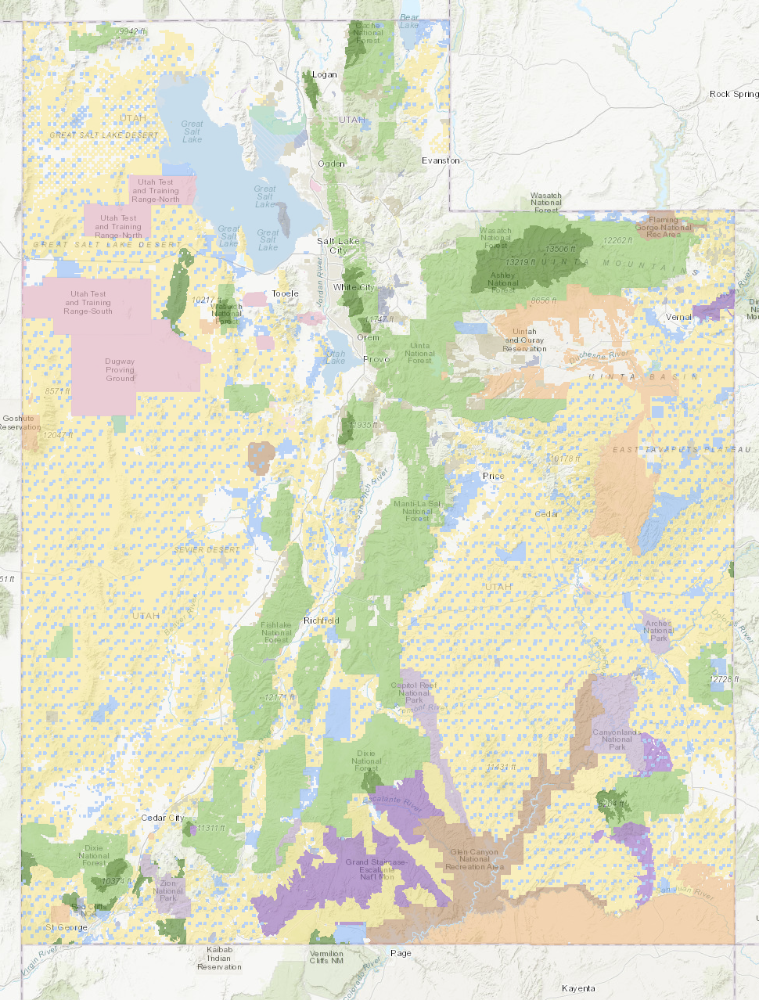
Utah has 3.4 million acres of Trustlands!

Slide 13
Oil Platform – Uintah County

Slide 14
Coal Loader and Feeder – Carbon County

Slide 15
Funding Flow Chart
Revenues Generated From Activities on School Trust Lands
Interest
Trust Land Management Expenses
Permanent State School Fund
Dividends
$ for Utah Schools
Capital Gains
Reinvested

Slide 16
1987 Balance: $ 15,271,659

Slide 17
2022 fund balance: over $2,500,000,000
The 2022-23 distribution to schools is $84,770.524
2022-23 Jordan School Allocation: $7,586,103

Slide 18
The Work of SCCs
Represent the school community
Prepare School LAND Trust Plan
Provide input on the Teacher and Student Success Act (TSSA)
Digital Citizenship review and School Safety Plan
Advise and make recommendations to school and district administrators and local school board

Slide 19
Council Membership
Principal and at least one school employee
Parent/guardian members
Must have at least 2 parent majority
Size is determined by the council
Stated in Rules of Order and Procedure
Member terms are 2 years
Terms should be staggered

Slide 20
Council Membership Roles
Principals-automatic council seat
Access and explain data
Ambassador
Resource to the chair and council
School Employees-elected by employees, 2 year term
Long-term vision of the school
Academic perspective
Parents-may be elected by other parents, 2 year term
It is about their children
Parent and community perspective

Slide 21
Member Elections (If needed)
Provide at least 10 days’ notice before voting takes place
Voting takes place over at least three consecutive school days
School must post:
The dates and times of the elections
A list of council positions that are up for election
Instructions for becoming a candidate for a community council position

Slide 22
Election of Chair & Vice-chair
The entire council elects their officers.
Chair is elected from parent members
Vice-chair may be a parent or employee
Principals don’t serve as officers but do vote
Voice vote may be done
If desired or contested: Secret Ballot, principal oversees with 1 employee and 1 parent
Appoint a member to take minutes

Slide 23
Jordan Parent Advisory Committee
All SCC Chairs are invited
Tuesday, October 18, 6:30-8:00 pm
JATC-South, Riverton

Slide 24
Conducting Meetings
Open to members of the public
No public discussion of HR issues
Managing the meeting
Begin on time & follow the agenda
Allow enough time for each agenda item
Keep the council on task & move the agenda along to end on time
Encourage all viewpoints to be heard
Motions for action items – quorum present
Comments and motions should go through the chair
Best for the chair to conduct when present

Slide 25
Responsibilities of Members
To make a conscientious effort to attend all meetings.
To act in good faith for the benefit of all students.
To participate in the development of the School Land Trust Plan and give feedback on the TSSA plan.
To be a positive and contributing member.

Slide 26
Website Requirements
Contact information of the SCC members
Meeting Agendas—posted 1 week before with date, time, place
Minutes for current school year meetings
Substance of matters proposed, discussed or decided, it must be on the agenda to take action
Teacher and Student Success Plan
Opportunities provided to parents by serving on the SCC and how parents can directly influence expenditure of LAND Trust money
Dollar amounts received by the school each year through the program

Slide 27
Rules of Order and Procedure
School Community Councils must adopt their own rules of order and procedure. These rules should be followed in conducting meetings, be posted on the school website, and be available at each meeting.
Removal or Replacement, Elections, How to make decisions
Must be posted on the SCC website
See sample at https://www.schools.utah.gov/schoollandtrust/councils

Slide 28
Teacher and Student Success Act (TSSA)
New in 2019 and distinct from the LAND Trust program
TSSA provides money directly to each Utah public school
Address needs unique to the school
To qualify for the money, schools must adhere to the parameters approved by the school board.
Requires input from the School Community Council (SCC)
SCC members should become familiar with the TSSA

Slide 30
School LAND Trust Plans

Slide 31
“It is a capital mistake to theorize before one has data. Insensibly one begins to twist facts to suit theories, instead of theories to suit facts.” ― Sir Arthur Conan Doyle, Sherlock Holmes

Slide 32
School LAND Trust Plan
Usually includes part of the TSSA plan
Describe how the school will improve or enhance academic achievement
Use money from the LAND Trust Allocation to fund the plan
2023-24 School LAND Trust Plan - due March 24, 2024

Slide 33
School LAND Trust Plan
Identify an academic need
Write a goal to address the need (SMART goals)
Majority vote of a quorum is required
Submit online for approval by the local school board
Implement the plan as approved

Slide 34
Carry-over Funds
They can be carried to the next year
If it is > 10% you will need to explain
In the early years it made some sense
Can be perceived that schools must not really need it
School LAND Trust Plans may be amended!

Slide 35
Summary
Appropriated by the legislature
Can be carried over
Only state that spends the funds at each school
Tailored to meet the needs of individual schools

Slide 36
The primary focus must be: What is in the best interest of students?

Slide 37
Questions?
Contact your local principal
Call or email Mike Anderson
michael.anderson@jordandistrict.org
801-567-8316
http://jordandistrict.org/schools/communitycouncil/

