Slide 1
High School Testing updates and reminders
principals meeting
Tuesday February 6, 2018
Jordan School District

Slide 4
SAGE 9-10:
SAGE Reading, Math, and Science will be administered this year – No ASPIRE
No SAGE writing for grades 9-10
Because there was no writing test when USBE originally announced ASPIRE for grades 9-10
Cost $107,000 for AIR to make the coding change
USBE assures that SAGE ELA Reading-only scores will still correlate with previous years’ SAGE ELA scores

Slide 5
R277-404-6 Revision: Effective January 3, 2018
“In accordance with Subsection 53A-15-1403(1), an LEA shall reasonably accommodate a parent’s or guardian’s request to allow a student’s demonstration of proficiency on a state required assessment to fulfill a requirement in a course.”

Slide 6
Implications:
If a course requirement was to pass a final exam or final project designed by the teacher, a proficiency rating of 3 or 4 on the SAGE for that course could satisfy that requirement
The student would have to earn a proficiency rating of 3 or 4; otherwise, they would need to fulfill the original course requirement
It would require signed permission from the parent/guardian
Kept in the CUM Folder – same procedure as a parent exclusion form
The teacher would have to track permission forms and check SAGE ratings on ORS (which are immediately available after the student has completed the test)

Slide 7
Implications:
An addendum to the teacher’s disclosure statement would need to be sent home
A new parent exclusion form is available on the assessment website that will include a parent opt-in option
CAUTION: This also means that parents can choose the course requirement that their child’s SAGE proficiency rating of 3 or 4 would replace – “reasonably accommodate”

Slide 8
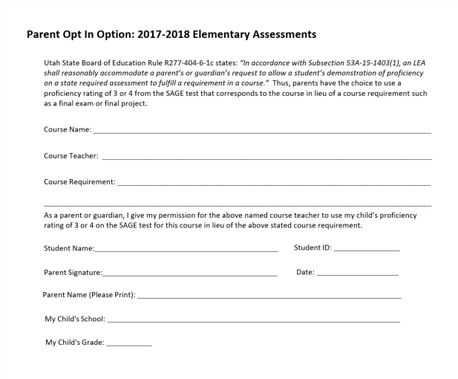

Slide 9
Knowing is half the battle…
What are your teachers going to say about this and how will you respond?
What will your parents do or say?

Slide 10
ACT: Student survey
Prior to testing day, students fill out a survey on their ACT bubble sheet
A proctor reads a script to students with instructions for each part of the survey
There are two questions that solicit inappropriate material from students – they ask for:
The student’s religious affiliation
The income of the student’s parents
ACT has created a new proctor script that will be sent out to school testing coordinators that instructs students to skip those two questions

Slide 11
ACT Writing:
The ACT Writing test is required this year for the 11th grade administration
An ACT Writing score is not required by any Utah universities
Like the rest of the test, ACT Writing is paper/pencil
IF students leave after the previous subject area tests:
They will still get a composite score
They will still get an English score
They will NOT get an English Language Arts score or a Writing score
Tricky Part: There is a required break before the writing test is given. Students need to secure and turn in their testing materials. If they don’t, we may have to file an irregularity report, which will could potentially result in ACT not scoring the entire test

Slide 12
Questions?

