Slide 1
Assessment updates and trainings
Principals Meeting
Tuesday, May 8, 2018
Elementary Schools

Slide 2
The New Computer Adaptive Test (CAT)
Waiting on a new name…
Writing prompt in 5th and 8th grades only
Randomized between opinion and informational writing
Multi-stage adaptive instead of item-adaptive
Benchmark will be available after Oct. 1, 2018
Interim will be available after Nov. 1, 2018
No science 6-8 Interims or Benchmarks will be available – Too few items
Remember: New name, new platform, same administration policies (opt outs, no incentive/disincentive, etc.), same questions

Slide 3
New CAT Trainings for Team Leads and Department Chairs
Required for Department Chairs and Grade Level Team Leads:
3-8th grades in math, ELA, science (4-8) and special education
Dates (half day sub provided):
Date | Location | Time
Monday, Sept. 17 | ASB - PDC 113 | 8-11 am, 12-3 pm.
Wednesday, Sept. 19 | ASB - PDC 103 | 8-11 am, 12-3 pm
Thursday, Sept. 20 | ASB - PDC 101 | 8-11 am, 12-3 pm
Monday, Sept. 24 | ASB - PDC 101 | 8-11 am, 12-3 pm
Tuesday, Sept. 25 | ASB - PDC 101 | 8-11 am, 12-3 pm
Wednesday, Sept. 26 | ASB - PDC 101 | 8-11 am, 12-3 pm

Slide 4
Optional New CAT Trainings
For grades 3-8 math, ELA, science (4-8) and special
education teachers that will be administering the new CAT
After contract time, paid at in-service rate
OPTIONAL, but encouraged
Date | Location | Time
Monday, Sept. 17 | ASB - PDC 102 | 3:30-6:30 pm
Tuesday, Sept. 18 | DO – Room 129 | 3:30-6:30 pm
Wednesday, Sept. 19 | DO – Room 129 | 3:30-6:30 pm
Thursday, Sept. 20 | DO – Room 129 | 3:30-6:30 pm
Monday, Sept. 24 | DO – Room 129 | 3:30-6:30 pm
Tuesday, Sept. 25 | DO– Room 129 | 3:30-6:30 pm
Wednesday, Sept. 26 | DO – Room 129 | 3:30-6:30 pm
Thursday, Sept. 27 | DO – Room 129 | 3:30-6:30 pm

Slide 5
Accountability Updates
No letter grade will be released to the public
SAGE performance data will be released to the public in November 2018
School Grading Report Cards will be published in December 2018

Slide 6
9th Grade SAGE and the ACT
ACT English, Reading, Math and Science test modules focus on similar critical thinking skills:
Examples:
Reasoning (if/then, compare/contrast, cause/effect)
Evaluating – determining importance, key details
Analysis - how would x be impacted if I changed y, inferring, predicting
Synthesis – applying learned concepts to other contexts

Slide 7
9th Grade SAGE and the ACT
Scores on the 9th grade SAGE and the 11th grade SAGE for the same cohort of students have a moderate correlation ranging from .6 to .8 on a 0-1 scale.
Correlation means that one variable tends to rise and fall with the other variable, but it doesn’t indicate a directional relationship.
For every increase of 30 scale score points on SAGE in 9th grade ELA and math, we can predict a 1 point ACT English and Math score increase.

Slide 8
9th Grade SAGE and the ACT
 | ACT English | ACT Reading | ACT Math | ACT Science
SAGE ELA | .783 | .685 | .626 | .770
SAGE Math | .657 | .646 | .718 | .781
SAGE Science | .617 | .607 | .629 | .697
ACT English |  | .772 | .692 | .879
ACT Reading | .772 |  | .719 | .880
ACT Math | .692 | .719 |  | .629
ACT Science | .879 | .880 | .908
Notes:
- Predicting ACT scores from SAGE become less reliable at the two extremes – the highest and lowest achieving students, but for the 70-80% of students in the middle, this is a reliable predictor.

Slide 9
9th Grade SAGE and the ACT
 | ACT English | ACT Reading | ACT Math | ACT Science
SAGE ELA | .783 | .685 | .626 | .770
SAGE Math | .657 | .646 | .718 | .781
SAGE Science | .617 | .607 | .629 | .697
ACT English |  | .772 | .692 | .879
ACT Reading | .772 |  | .719 | .880
ACT Math | .692 | .719 |  | .629
ACT Science | .879 | .880 | .908
Notes:
They all have somewhat of a correlation that probably translates to good standardized test-taking skills
They would also have some correlation based on similar skill sets used from one test to another:
Like reading skills used on the ACT science
Like calculation skills used on the ACT science
Less of a correlation between SAGE and ACT science because SAGE asks for more content knowledge specific to the content that is being tested at the 9th grade level (earth systems and biology) while ACT asks for more science reasoning skills (i.e., determining what has changed with new evidence, determining which experiment might be better, analyzing and predicting, etc.) that are translatable across science contents.

Slide 10
9th Grade SAGE and the ACT
 | ACT English | ACT Reading | ACT Math | ACT Science
SAGE ELA | .783 | .685 | .626 | .770
SAGE Math | .657 | .646 | .718 | .781
SAGE Science | .617 | .607 | .629 | .697
ACT English |  | .772 | .692 | .879
ACT Reading | .772 |  | .719 | .880
ACT Math | .692 | .719 |  | .629
ACT Science | .879 | .880 | .908
Notes:
You’ll also notice that ACT Science has a higher correlation with the other three ACT tests. The same kind of reasoning, analyzing, predicting, and evaluating skills used in the other tests are used even more in the ACT science.
If we focused on those same skill sets in our instruction, we could positively effect the learning outcomes as measured by SAGE, the new CAT, Aspire as well.

Slide 11
9th Grade SAGE and the ACT
If Johnny is a fast runner in track, he will likely be a fast runner in football because they share the same skill. However, it doesn’t mean that he will likely be able to catch the football well.

Slide 12
9th Grade SAGE and the ACT
If Jane is a good reader, she will likely do well on a reading test.
She will also likely do well on content area tests that require more reading skills like science.

Slide 13
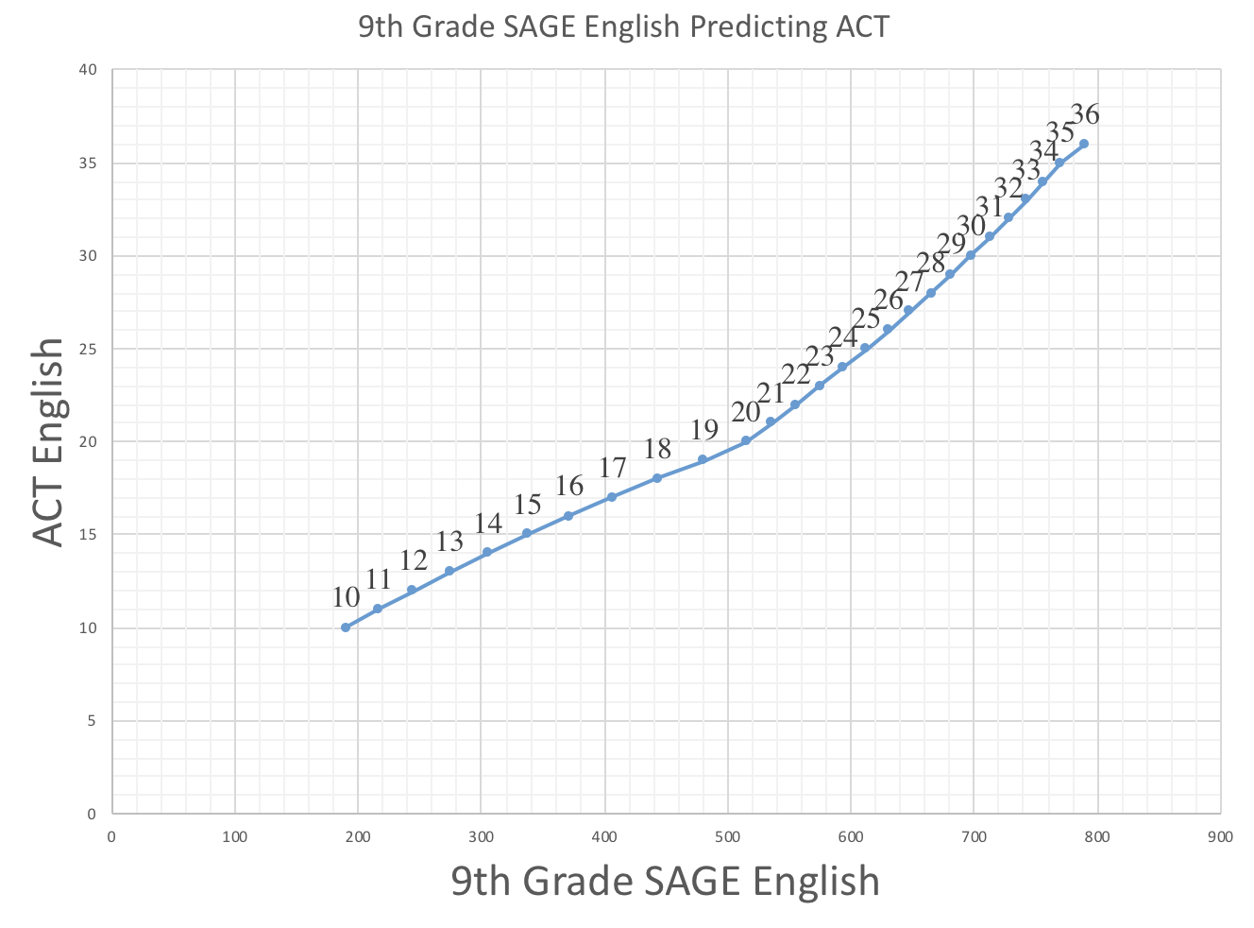
ACT Mean = 20 SAGE 9 Mean = 450 Most reliable window of prediction = 350-550
Holly’s graph

Slide 14
ACT Mean = 20.6 SAGE Math Mean = 472 Most Reliable Window of Prediction = 372-572

Slide 15
The problem with predicting ACT scores:

Slide 16
It assumes that the variables remain the same

Slide 17
Conclusions
SAGE and ACT are correlated
Correlations based on like skill sets between both tests
Good test taker
Strong reasoning, analyzing, and evaluating skills
Strong literacy skills
SAGE performance can moderately predict ACT performance
Instruction that emphasizes reasoning, analyzing, and evaluating skills/opportunities can raise SAGE scores which will therefore raise ACT scores
Improving reading and writing skills will raise SAGE scores which will therefore raise ACT scores

Slide 18
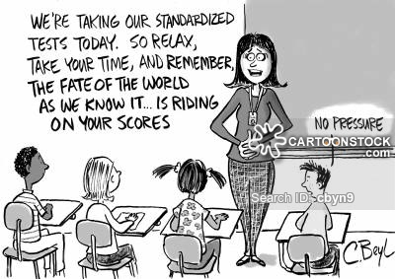
Questions?

