Slide 1
Elementary School Testing updates and reminders
principals meeting
Wednesday, January 31, 2018
Jordan School District

Slide 3
SAGE Training for principals and test coordinators: Thursday, Feb. 8 – 8 am in the ASB Auditorium Tuesday, Feb. 20 – 8 am in the ASB auditorium

Slide 4
SAGE Writing
Only 1 writing prompt this year
Students will be randomly selected within a class
Could be Informative or argumentative

Slide 5
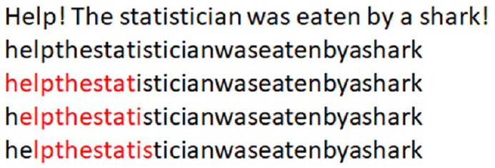
SAGE Writing
New Writing Scoring Engine (both codes will automatically trigger human scoring):
Prompt_Copy_Match = The student has copied +70% of the stimulus text in their writing
This can be an issue with younger students that will generate less writing
Duplicate_Text = When a student types a word, phrase, sentence or paragraph over and over again – 60% threshold
Recommendation: Teachers should give one of the SAGE Benchmarks to see how pervasive issues with these two codes will be and provide more instruction prior the SAGE Summative Test

Slide 8
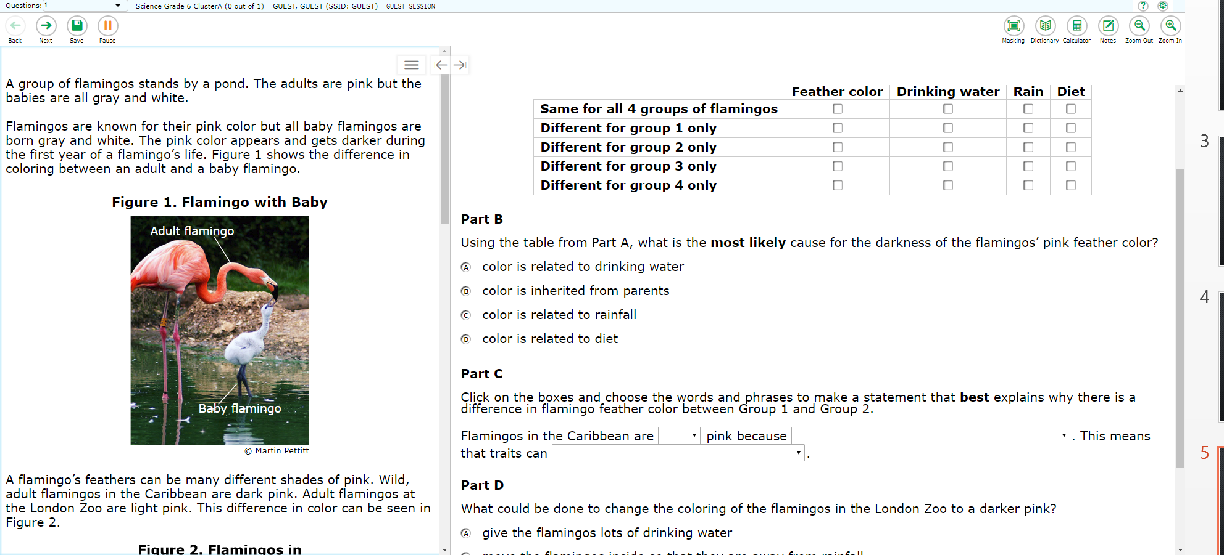
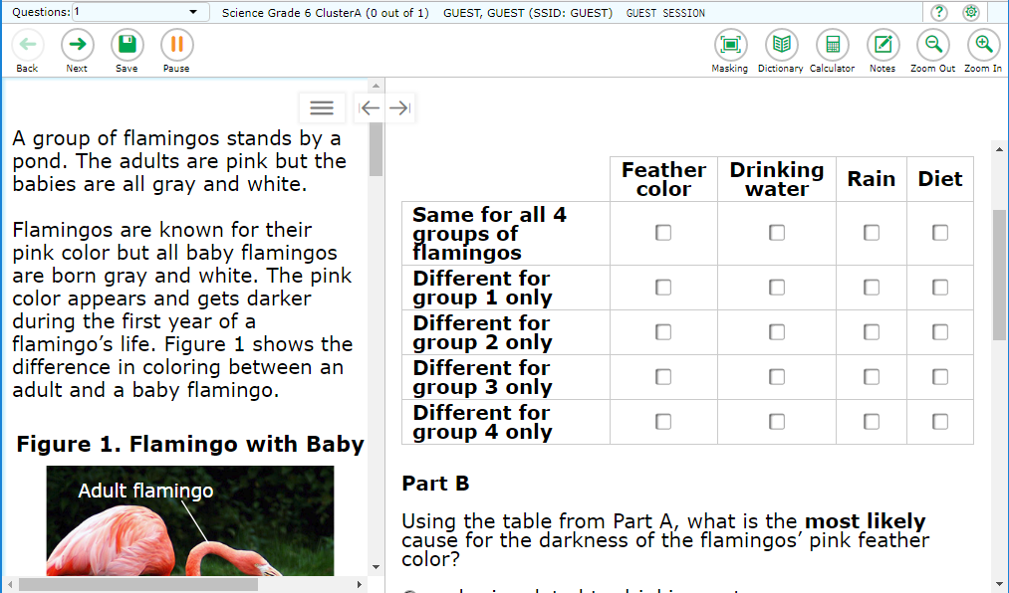
SAGE Science: Grades 6-8 SEEd Clusters
SEEd cluster questions don’t work as well on small screens (like iPads and Chromebooks) – crowded work space and more scrolling

Slide 9
SAGE Science: Grades 6-8 SEEd Clusters
Recommendation: Reserve labs with larger screens for SAGE science tests whenever possible
Recommendation: Have students use the science practice clusters for grades 6-8 on the SAGE Portal prior to SAGE Summative
Recommendation: Use USB connected mice on Chromebooks to help scroll up and down
If you need more mice, take the survey at this link: https://tinyurl.com/y7s7oogd

Slide 10
R277-404-6 Revision: Effective January 3, 2018
“In accordance with Subsection 53A-15-1403(1), an LEA shall reasonably accommodate a parent’s or guardian’s request to allow a student’s demonstration of proficiency on a state required assessment to fulfill a requirement in a course.”

Slide 11
Implications:
If a course requirement was to pass a final exam or final project designed by the teacher, a proficiency rating of 3 or 4 on the SAGE for that course could satisfy that requirement
The student would have to earn a proficiency rating of 3 or 4; otherwise, they would need to fulfill the original course requirement
It would require signed permission from the parent/guardian
Kept in the CUM Folder – same procedure as a parent exclusion form
The teacher would have to track permission forms and check SAGE ratings on ORS (which are immediately available after the student has completed the test)

Slide 12
Implications:
An addendum to the teacher’s disclosure statement would need to be sent home
A new parent exclusion form is available on the assessment website that will include a parent opt-in option
CAUTION: This also means that parents can choose the course requirement that their child’s SAGE proficiency rating of 3 or 4 would replace – “reasonably accommodate”

Slide 13
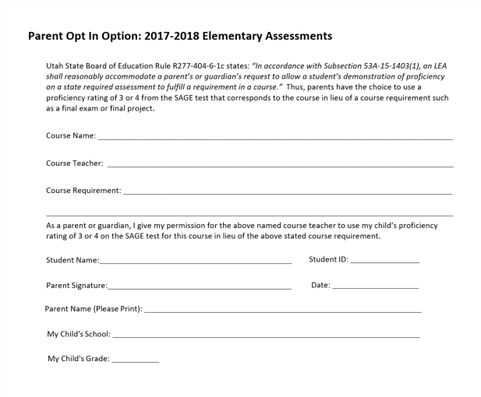

Slide 14
Knowing is half the battle…
What are your teachers going to say about this and how will you respond?
What will your parents do or say?

Slide 15
Questions?

